Slide 1




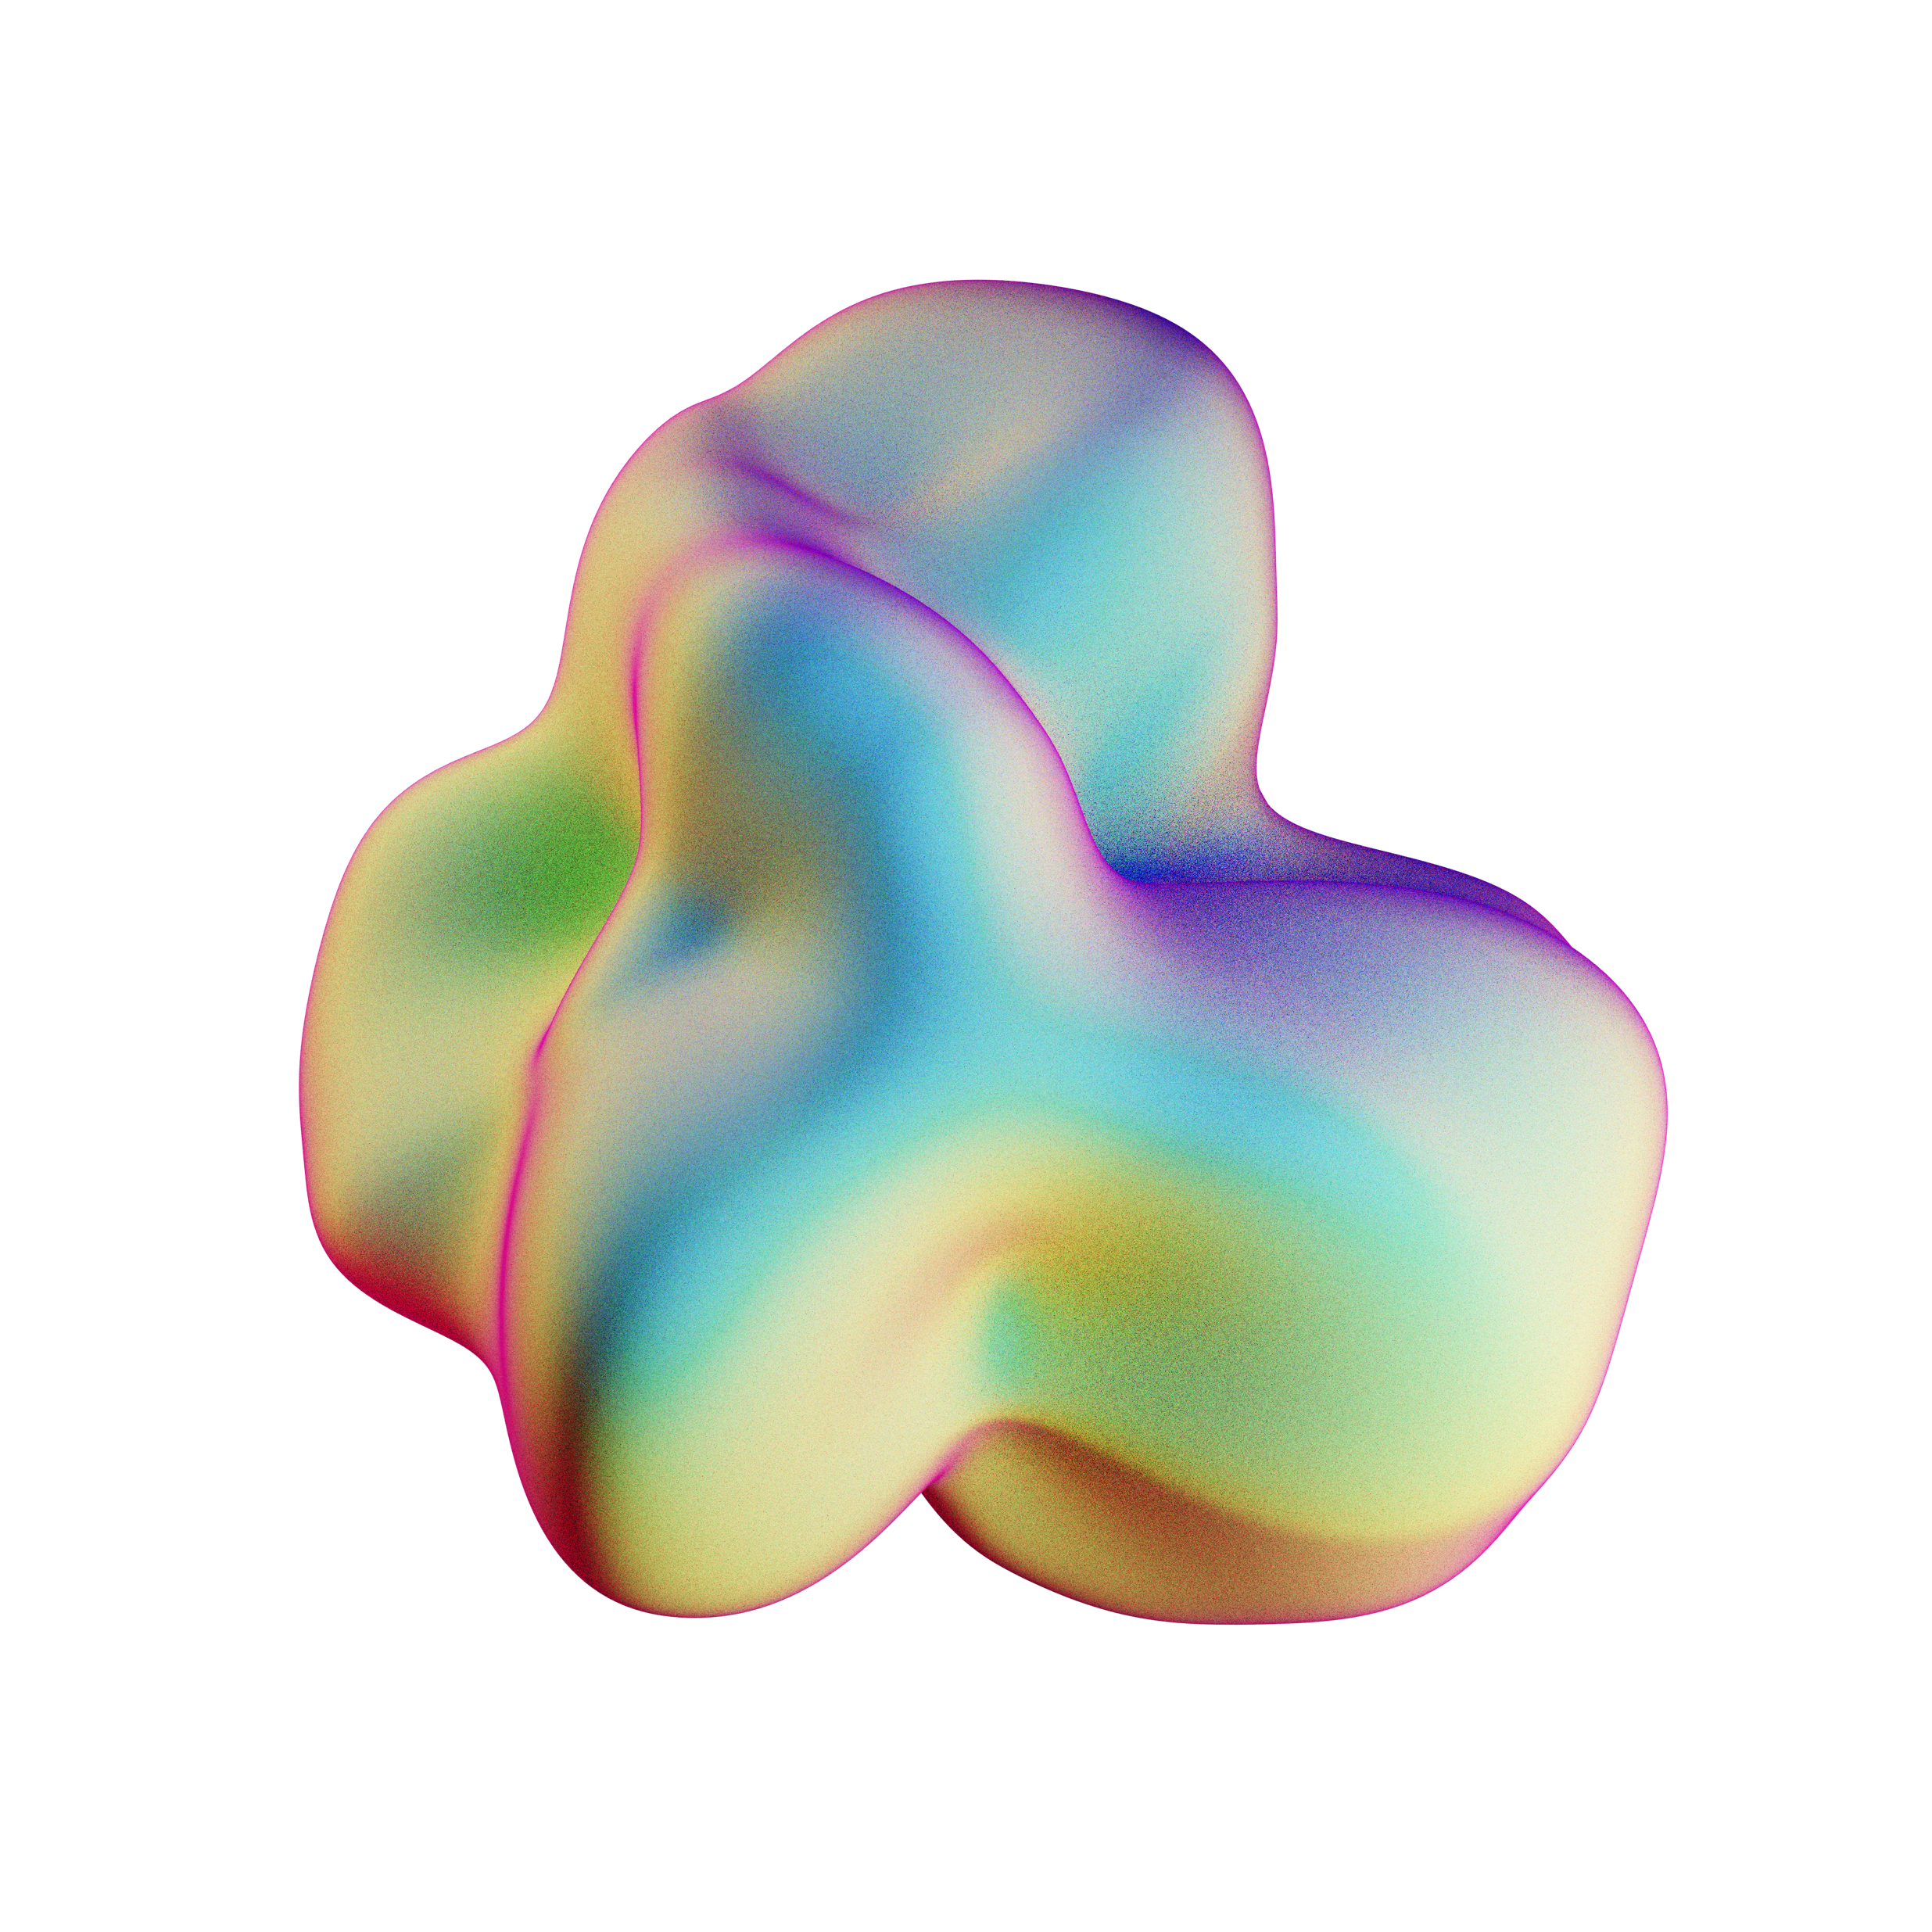




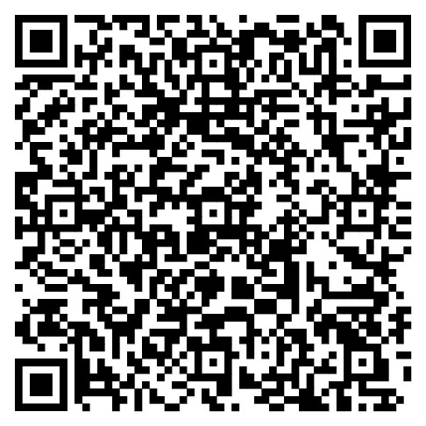

GLOBAL HACKATOM
SERBIA
STUDENT TEAMS COMPETITION IN
NUCLEAR POWER TECHNOLOGIES: FUTURE PROSPECTS
26-27 MAY, 2026
UNIVERSITY OF BELGRADE
TEAMS OF 6 MEMBERS (5 STUDENTS
+ 1 RESEARCH SUPERVISOR)*
ASK YOUR QUESTIONS
AVNakhabov@mephi.ru
REGISTER YOUR TEAM
BEFORE 22 MAY, 2026
@
*Age of participation is up to 35 years, including the team supervisor

